Slide 1


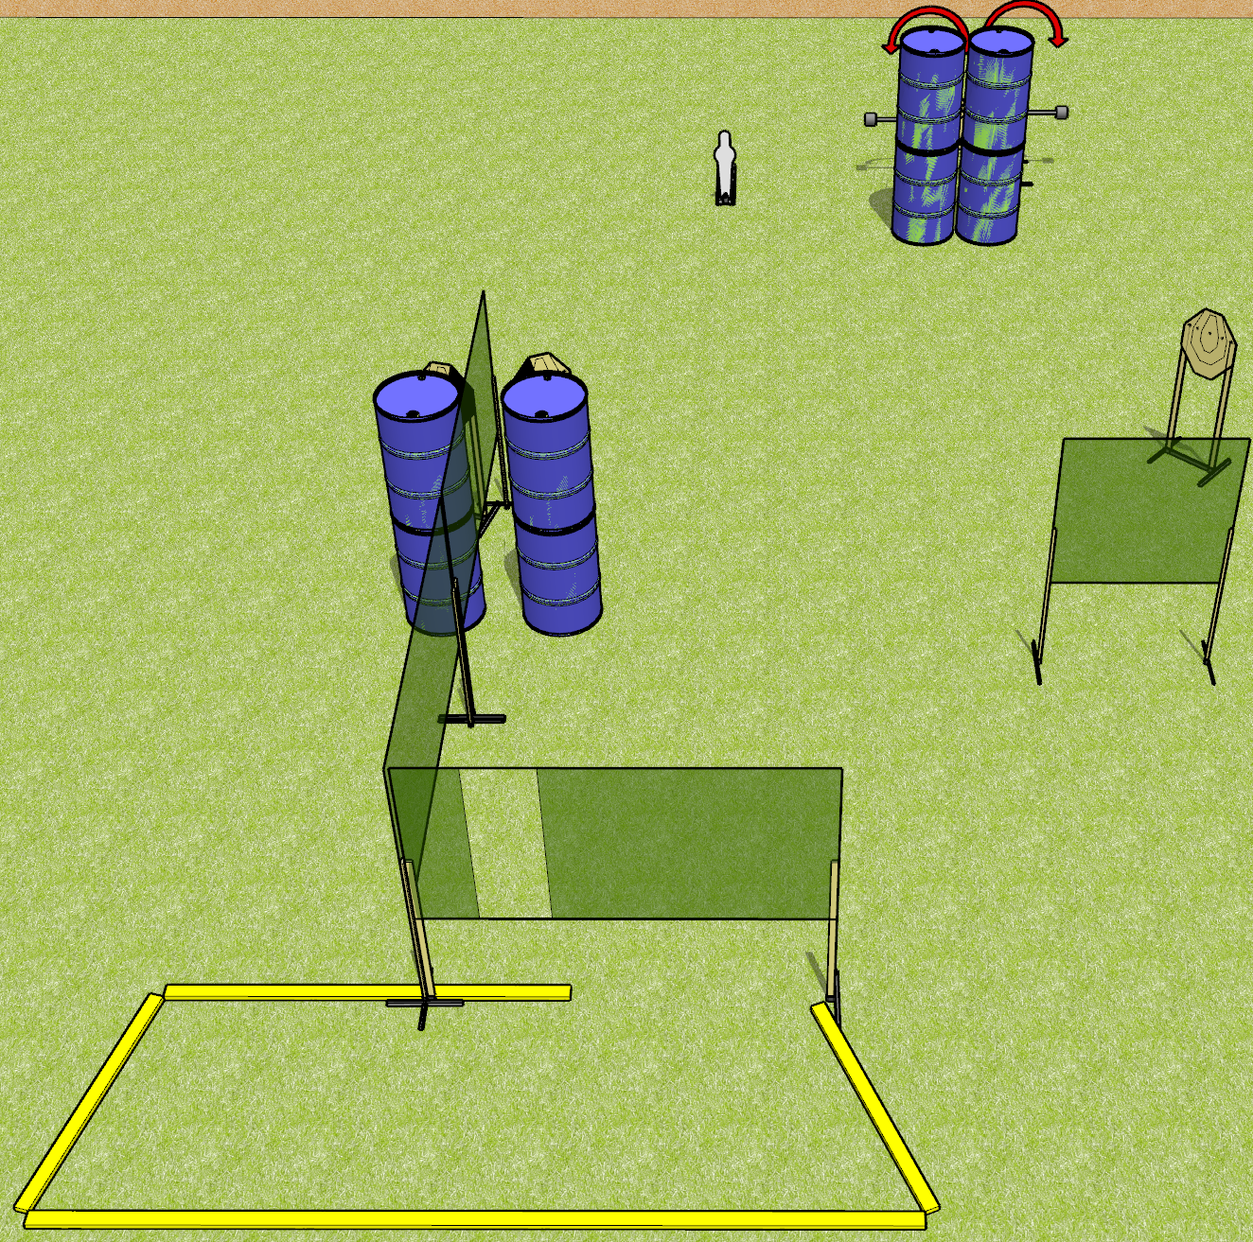
 | Dothan Gun Club – USPSA Match Lean and Mean Course Designer : Drew Coleman
Round Count 11 rounds 5 IPSC targets 1 mini popper
Equipment List 6 wall feet 2 medium fault lines 2 swingers + activators 1 left + 1 right dia, 3 targets

Slide 2
Lean and Mean
Written Stage Briefing
Lean and Mean is an 11 round, 55 point, Comstock course of fire. There are 5 IPSC targets and 1 mini popper. The best 2 hits on paper will score, and steel must fall to score. The start signal is audible.
The swingers are activated by the mini popper and remain visible at rest.
Handgun start position is inside the shooting area, wrists below belt. Handgun is loaded and holstered.
PCC start position is inside the shooting area, stock on belt. Loaded carbine is held with both hands, safety on.
On start signal, engage targets as they become available from within the shooting area.

